Slide 1
Semaphores

Slide 2
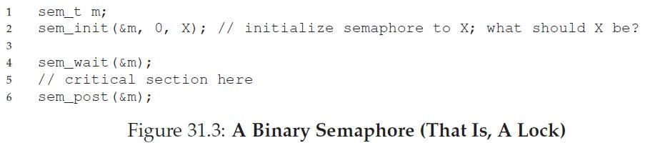
What is a semaphore?
Synchronization primitive like condition variables
Semaphore is a variable with an underlying counter
Two functions on a semaphore variable
  Up/post increments the counter
  Down/wait decrements the counter and blocks the calling thread if the resulting value is negative
A semaphore with init value 1 acts as a simple lock (binary semaphore = mutex)

Slide 3

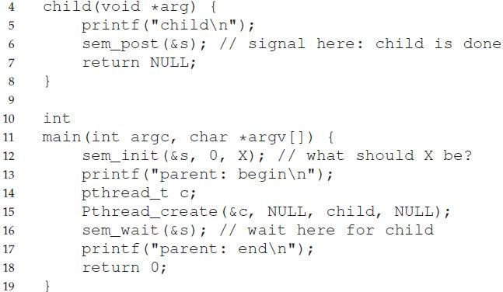
Semaphores for ordering
Can be used to set order of execution between threads like CV
Example: parent waiting for child (init = 0)

Slide 4
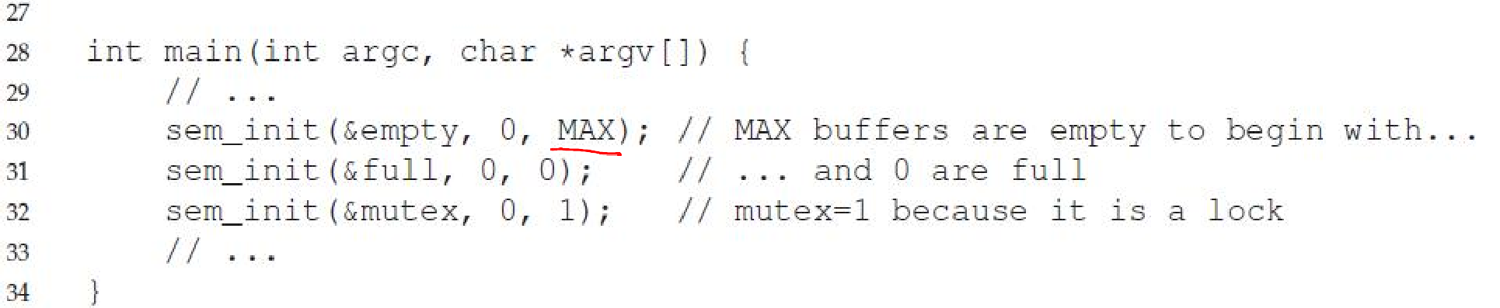
Example: Producer/Consumer (1)
Need two semaphores for signaling
  One to track empty slots, and make producer wait if no more empty slots
  One to track full slots, and make consumer wait if no more full slots
One semaphore to act as mutex for buffer

Slide 5
Example: Producer/Consumer (2)

Slide 6
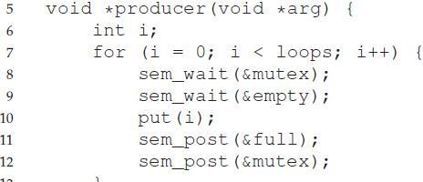
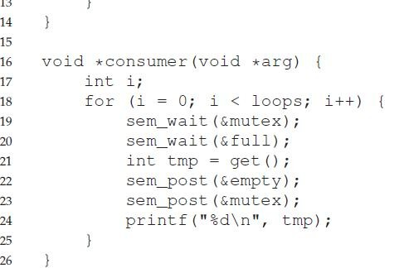
Incorrect solution with deadlock
What if lock is acquired before signaling?
Waiting thread sleeps with mutex and the signaling thread can never wake it up

